Slide 1
Tagging & Tracking Overview
GTM Readiness & Performance Teams
June 2026

Slide 2
Module1: Introduction & Overview

Slide 3
1
Getting Started: Need to put something here
Agenda: Training Overview
2
The Data Journey: ?????
3
Setting Up for Success: ??????.

Slide 4
Strategic Value of Tagging & Tracking
Why We Track: Flawless data integrity connects every marketing dollar to real-world sales outcomes—proving ROI, unlocking automated customer journeys, and empowering sellers to win deals.
Optimize Spend
Personalize Journeys
Empower Sellers
Pinpoint exactly which campaigns and channels yield actual closed-won pipeline. Shift budgets in real time from low-intent channels to top-performing initiatives.
Trigger highly targeted, program-specific "always-on" nurture sequences. Deliver hyper-relevant content to the buyer based on precise digital hand-raisers.
Deliver rich, contextual content consumption details to CRM profiles. Help sales reps bypass dry, cold calls to start highly specific, high-value conversations.

Slide 5
Tracking ID Types
Activity ID
Drive To ID
Offer ID
The Activity ID is the foundational umbrella identifier used to track specific marketing initiatives that generate customer activity in support of global campaigns and programs.
The Drive To ID denotes the specific marketing channel or vehicle being used to direct customers to our digital destinations (such as Cisco.com).
The Offer ID tracks the specific value exchange given to customers to encourage engagement.
Acts as the mandatory trigger for lead generation, entering the scoring program, and adding prospects to nurture journeys.
Tracks the path a user took to get to our site, such as Paid Search or social media platforms.
Monitors the performance of assets or incentives provided to customers in exchange for a specific action, such as filling out a form.
What it Does
Financial Alignment: Every Activity ID must align with a specific cost value in marketing (e.g., an Allocadia budget line item, formal sales requests, or a specific series of events/webinars).
Naming Convention: Names must reflect the specific marketing initiative, including its objective and target audience.
One ID Per Asset: Use exactly one unique Offer ID for a specific asset or offer. Do not create multiple Offer IDs based on the different channels or campaigns driving traffic to that offer.
Sales Enablement (Naming): The offer name serves as a direct signal to sellers; the name must contain enough context for them to use it as a conversation starter.
One-to-Many Relationship: A single Activity ID can be communicated through one or multiple Drive To IDs (e.g., one campaign running across both Facebook and LinkedIn).
Exceptions: Not all marketing vehicles will require a Drive To ID (e.g., offline or non-digital channels like direct audio).
Key Rules
cc0013423
EMEA Band A Digital Marketing - ABX Cross-sell Cloud management solution to Manufacturing Catalyst customers
oemels001119
Owned - Email - Eloqua Campaign Emails
trlsc027054
Cisco Secure Firewall Free Trial Security
Example

Slide 6
Module2: Activity IDs

Slide 7
Operational Impact of an Activity ID
Lead Scoring
Bypasses the scoring model entirely if transactions lack a CCID, blocking vital last-touch details from sellers.
The Engine of Data Integrity
Activity IDs are not just tracking parameters—they are critical systemic requirements that directly drive downstream sales context, automated lead routing, and pipeline reporting accuracy.
Lead Generation
Enforced by system rules in SFDC; leads cannot be generated in the VDC without an active Activity ID.
Program Alignment
Unlocks the mandatory 80% campaign alignment target. Accreditation relies entirely on ID data attributes.
Marketing Journeys
Automatically routes contacts into structured, always-on campaigns or generic journeys using program metadata.
Reporting
Feeds full-funnel pipeline reporting and fractional attribution models to evaluate real-world ROI.

Slide 8
Structure of an Activity ID
1
On Creation of an Activity ID a CCID is automatically generated
CCID
1
cc010898
2
Passed downstream to sellers & must reflect the specific marketing activity used to target the customer.
Information
Name:
Drive engagement and pipeline growth in EMEA Band A mid-market segment relating to Zero Trust Access
Description:
Drive targeted engagement and accelerate pipeline growth within the EMEA Band A mid-market segment. By focusing specifically on Zero Trust Access solutions, the initiative addresses critical security needs for growing organizations across the region. Ultimately, it establishes a strategic framework to capture market share and nurture high-value prospects through dedicated security messaging
2
3
A coordinated, structured set of marketing activities targeted at a specific audience segment to achieve a defined, short-term objective..
Campaign
Campaign
Program
Motion
4
A broader, ongoing strategic framework that encompasses and coordinates multiple related campaigns and initiatives over a longer period.
Future-Proofed Workplaces
Mid Market Networking
Scale
Program
3
4
5
5
How teams target prospects based on personalization level, ranging from high-touch ABM and ABX to broad-reach Scale Marketing
Motion

Slide 9
Create Multiple IDs for Each of your Campaigns
cc010898
cc010912
Name:
Drive engagement and pipeline growth in EMEA Band A mid-market segment relating to Zero Trust Access
Description:
Drive targeted engagement and accelerate pipeline growth within the EMEA Band A mid-market segment. By focusing specifically on Zero Trust Access solutions, the initiative addresses critical security needs for growing organizations across the region. Ultimately, it establishes a strategic framework to capture market share and nurture high-value prospects through dedicated security messaging
Name:
AMER Mid-Market Secure Campus & Branch Connect
Description:
This campaign focuses on driving engagement and pipeline growth within the Americas mid-market segment by highlighting secure campus and branch networking solutions. It addresses the critical need for midsize businesses to deploy scalable, robust, and highly secure infrastructure across distributed office environments. Through targeted messaging, the initiative aims to accelerate the sales cycle and capture expanding network security opportunities across the region.
Campaign
Program
Motion
Campaign
Program
Motion
Future-Proofed Workplaces
Mid Market Networking
Scale
Future-Proofed Workplaces
Mid Market Networking
Scale
cc010918
cc01102
Name:
EMEA Enterprise AI-Driven Network Assurance (Powered by ThousandEyes)
Description:
Driving adoption of AI-powered network assurance and visibility across the EMEA market by showcasing the native integration of Thousand Eyes with Cisco networking hardware. It highlights how organizations can leverage deep, granular insights across their entire digital infrastructure to proactively isolate performance bottlenecks and drastically reduce mean time to repair (MTTR).
Name:
Global Enterprise: Unified Defense Framework for Neocloud Security
Description:
This campaign introduces a comprehensive, layered security framework designed to embed robust protection across the Management Plane, Perimeter, Fabric, and Workload layers of Neocloud environments. By highlighting the integration of Cisco Secure Firewall, the initiative showcases how enterprise organizations can achieve high-performance macrosegmentation and advanced threat defense across their entire digital ecosystem.
Campaign
Program
Motion
Campaign
Program
Motion
Future-Proofed Workplaces
Up Market Networking LDOS
Scale
AI-Ready Data Centers
Neocloud
Scale

Slide 10
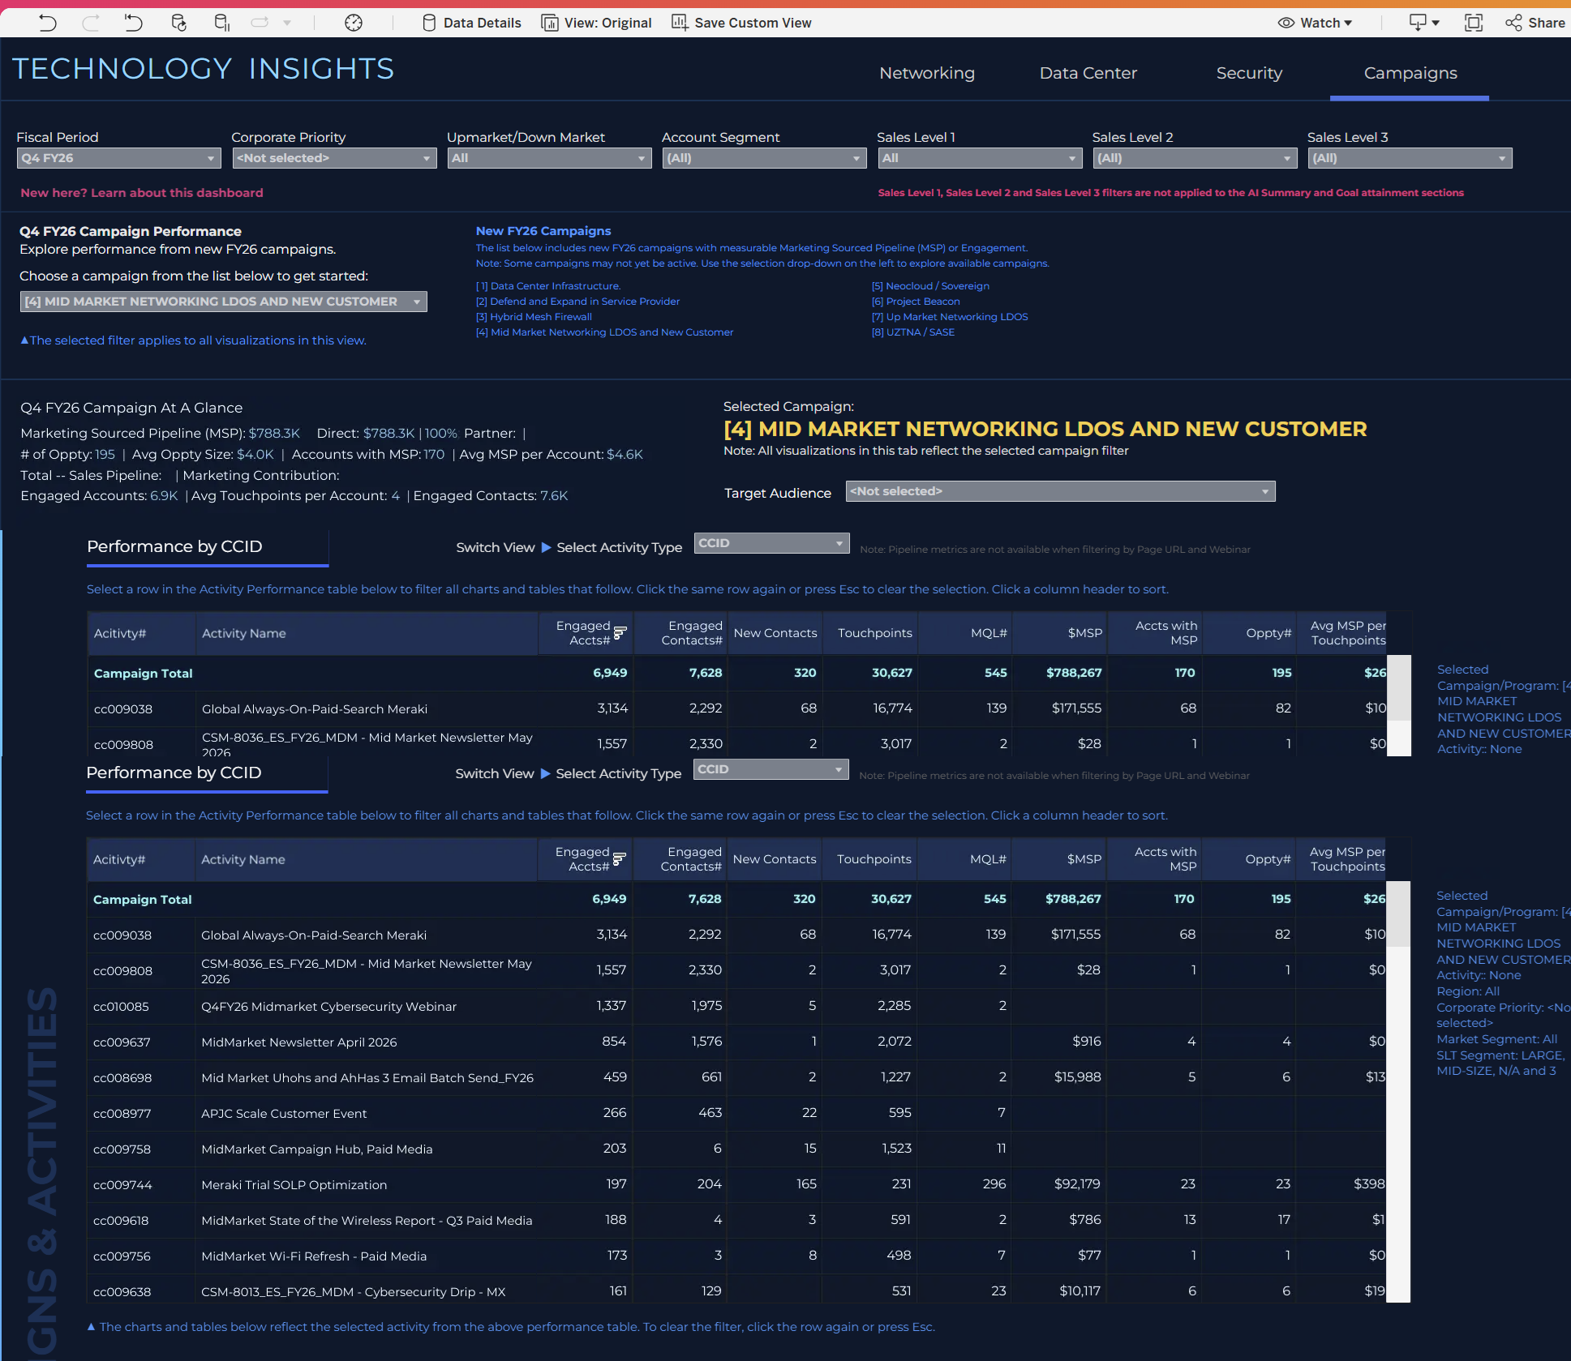
Technology Insights Reporting
1
Data is strictly limited to campaigns aligned with the FY26 strategic framework.
Framework
2
Selecting a campaign instantly updates the entire tab to show its specific performance results.
Dynamic
3
Engagement and pipeline metrics are automatically derived from tracking IDs (CCID, OID, EID) mapped via tagging metadata.
ID Driven
4
Includes all pipeline impacted by campaign-linked activities, even if it falls outside the core target product mix.
Pipeline
5
This view isolates the exact engagement and pipeline generated by your selected campaign's tracking tags.
Bottom Line
Best Used to Answer:
How did a specific campaign (e.g., Mid Market LDOS) perform end-to-end?
Which specific activities, offers, and events successfully drove engagement and pipeline for this campaign?
Tech Insights

Slide 11
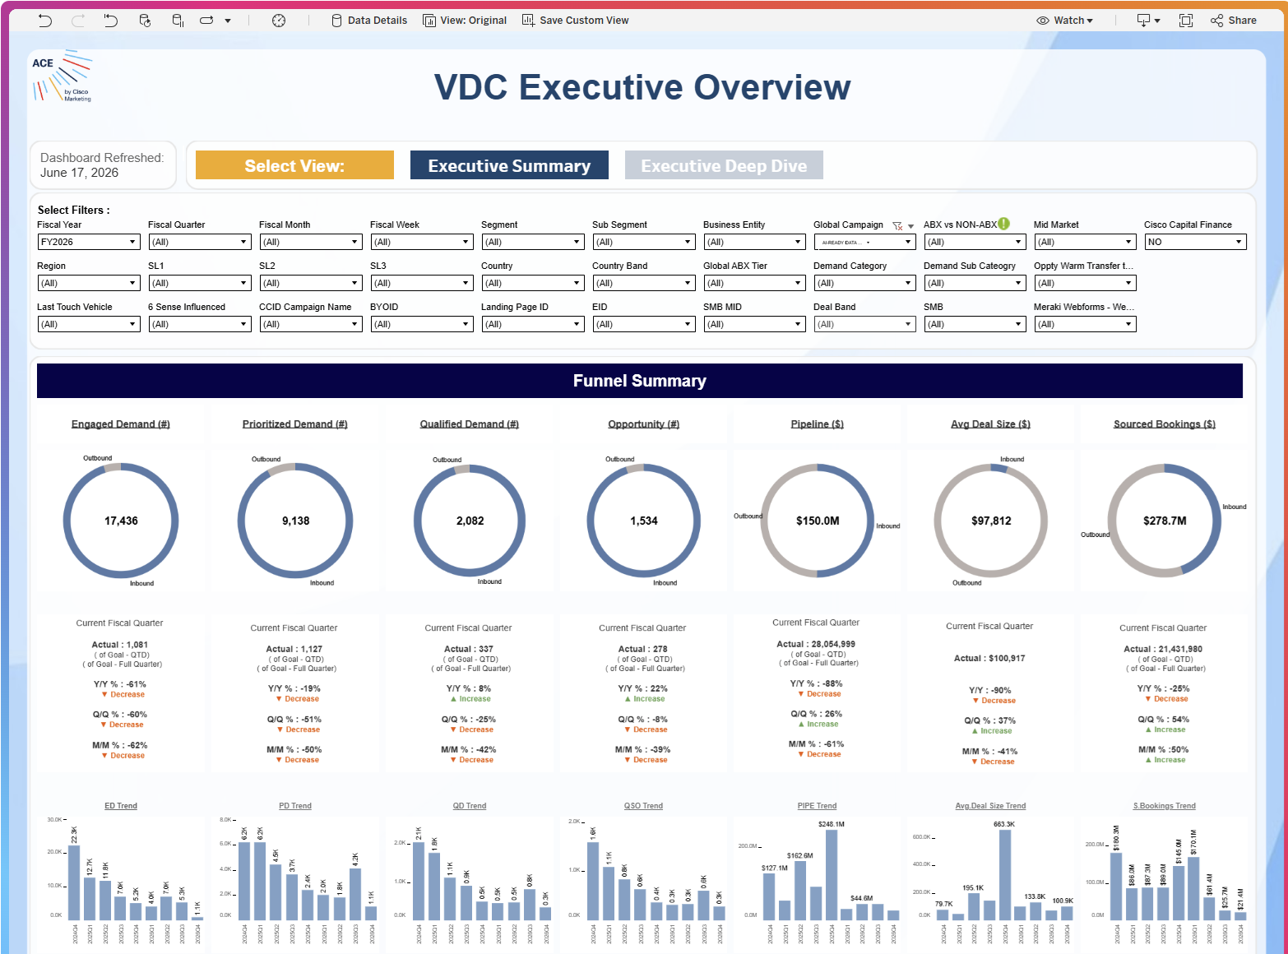
VDC Executive Overview
1
Tracks core marketing performance metrics across the entire lifecycle
Funnel
2
Real-time performance against quarterly goals alongside year-over-year (Y/Y), quarter-over-quarter (Q/Q), and month-over-month (M/M) growth trends.
Goals
3
The entire Funnel Summary can be sliced by specific tagging IDs, allowing teams to isolate the exact impact of specific marketing initiatives.
Filtering
4
Inbound vs Outbound
break down volume and revenue metrics by traffic type (Inbound vs. Outbound)
Why CCID Filtering is Possible:
Because the CCID (Campaign Control ID) is captured system-wide at the lead level, it embeds key campaign and program data directly into the lead record. This metadata acts as the connective tissue that allows the dashboard to instantly filter and attribute downstream revenue, bookings, and pipeline back to the originating marketing campaign.
VDC Executive Overview

Slide 12
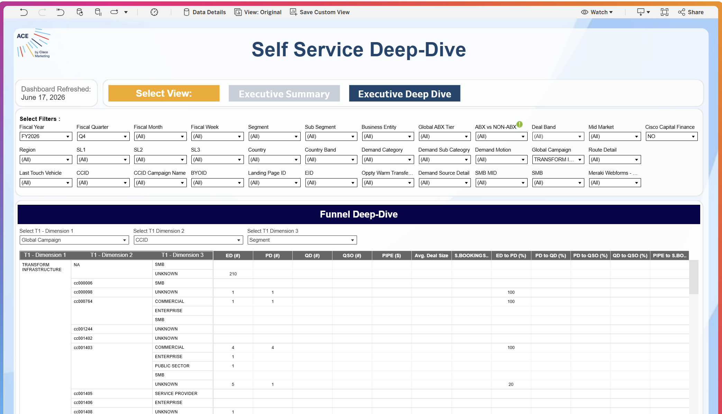
Self Service Deep Dive
1
Data is strictly limited to campaigns aligned with the FY26 strategic framework.
Framework
2
Selecting a campaign instantly updates the entire tab to show its specific performance results.
Dynamic
3
Engagement and pipeline metrics are automatically derived from tracking IDs (CCID, OID, EID) mapped via tagging metadata.
ID Driven
4
Includes all pipeline impacted by campaign-linked activities, even if it falls outside the core target product mix.
Pipeline
5
This view isolates the exact engagement and pipeline generated by your selected campaign's tracking tags.
Bottom Line
Best Used to Answer:
How did a specific campaign (e.g., Mid Market LDOS) perform end-to-end?
Which specific activities, offers, and events successfully drove engagement and pipeline for this campaign?
Self Service Deep Dive

Slide 13
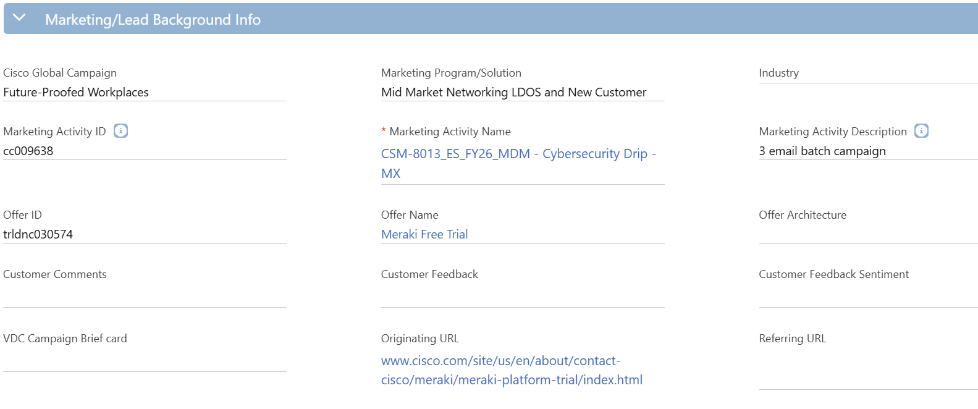
Seller Enablement
Create a lead with CCID cc010296
And Offer ID dmomrk033343

Slide 14
Module 3: Drive To & Offer IDs

Slide 15
Structure of a Drive To ID
The Traffic blueprint
The Drive To ID serves as a standard, reusable taxonomy blueprint that explicitly defines the target audience, messaging, and execution channel. By providing the foundational data required for channel-level operational reporting, it optimizes marketing spend for maximum ROI while powering both the HVE and MSP reporting frameworks to accurately credit the digital entry points driving customer action.
1
On Creation of an Drive To ID a DTID is automatically generated
DTID
2
Standardized naming convention of Type – Vehicle – Short Name
Description
3
Paid (sponsored), Owned (internal databases), or Earned (organic reach). Optimizing specific content delivery.
oemels001119
1
Audience
2
Description:
Owned - Email - Eloqua Campaign Emails
4
Standardizes the specific communication channel utilized (Email, Paid Social, Display). Ensuring clean normalized performance comparisons across channels.
Vehicle
Type
Vehicle
Vendor
Owned
Email
Eloqua
5
Identifies the exact execution technology or publisher platform. This enables pinpoint tactical analysis of partner-level efficiency and ROI.
Vendor
3
4
5

Slide 16
Structure of an Offer ID
The Asset blueprint
The Offer ID serves as a standard, asset-specific taxonomy blueprint that explicitly defines the high-value gated content, experiences, and incentives consumed by our customers. By embedding rich, descriptive context directly into the lead record, it arms sales teams with the immediate intelligence needed to initiate highly targeted conversations while fueling downstream product marketing analytics to isolate and scale our highest-converting digital assets.
1
Automatically generated code that uniquely tracks this asset across all digital systems.
OID
2
Breaks down the specific features or solutions covered to provide the seller with actionable context.
Description
3
Categorizes the delivery format of the asset—such as a Demo, or Webinar—allowing marketing teams to analyse which types of gated experiences convert best.
dmomrk033343
1
Type
Name:
Cisco AI Capabilities Demo
Description:
Primarily: AI Canvas, AI Assistant, and Agentic Ops as an overall concept/solution
2
4
Language
Denotes the localized language version of the asset, ensuring accurate global reporting.
Type
Language
Activity ID
Demo
English
cc009328
5
The Activity ID that links this specific offer back to its parent marketing program ensuring lead generation and pipeline metrics are credited correctly
Activity ID
3
4
5

Slide 17
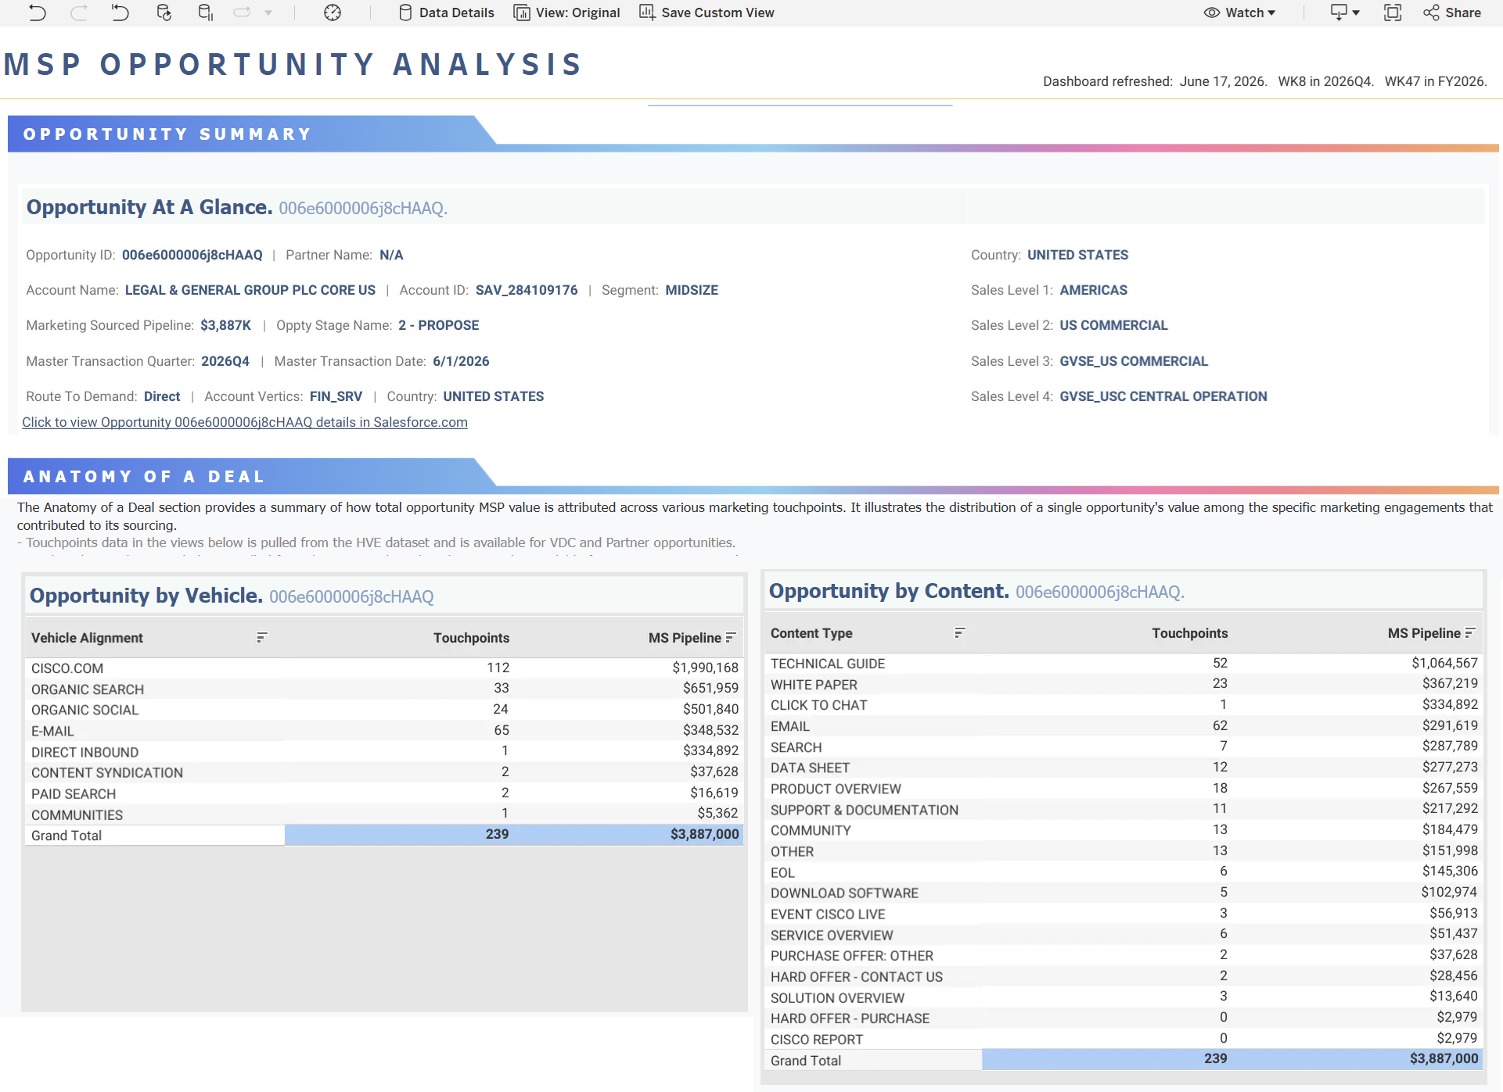
Anatomy of a Deal
1
Channel Performance
A single deal can contain multiple touchpoints, correct Drive To IDs ensure that every interaction is accurately bucketed into its specific channel vehicle
2
Asset Attribution
Capture the assets driving the deal &maps the specific marketing asset to the touchpoint, showing what content types are influencing the pipeline and yielding return.
3
Touchpoint data for the HVE dataset aligns to Offer & Drive To IDs
HVE
4
MSP
Ties touchpoints to an actual dollar value, clean data mapping demonstrates impact on revenue.
5
Budget
Anatomy of a deal show us which combinations of vehicles & content deliver the most cost-effective path to conversion
Anatomy of a Deal

Slide 18
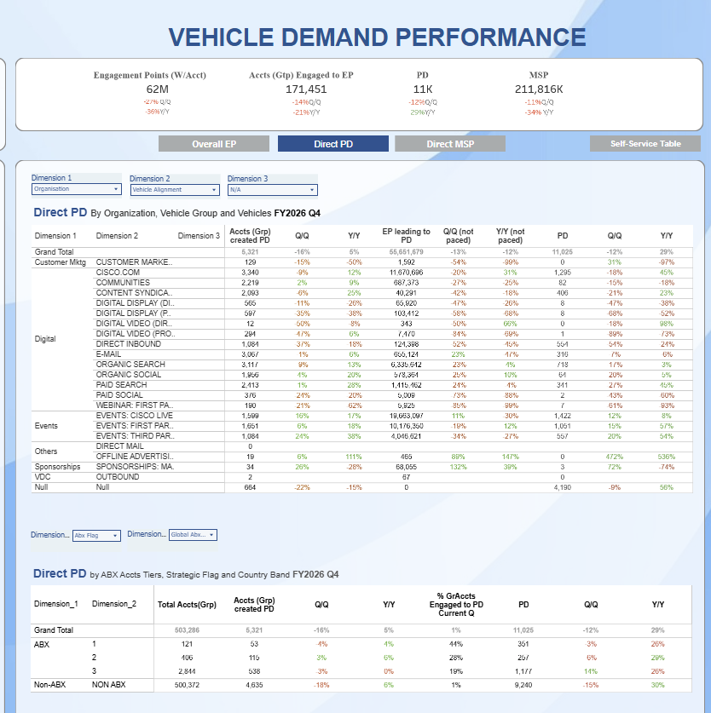
Vehicle Demand Performance
1
Fair Credit
Correct setup and use of DTID ensures teams receive accurate, proportional credit for every engagement and dollar of pipeline
2
Account Penetration
Provides feedback on how effectively targeted plays are penetrating high value Tier 1, 2 & 3 accounts showing the success of ABM, ABX strategies
3
Shows the percentage of the channel traffic coming from high-priority accounts vs. anonymous web traffic, to drive more defined targeting parameters.
Budget Waste
4
Growth
Q/Q & Y/Y reporting in relation to vehicles allows us to track upward growth trends to justify scaling successful programs
5
Defend
Budget
Provides the accurate data to defend budget and secure funding for future initiatives
Vehicle Demand Performance

Slide 19
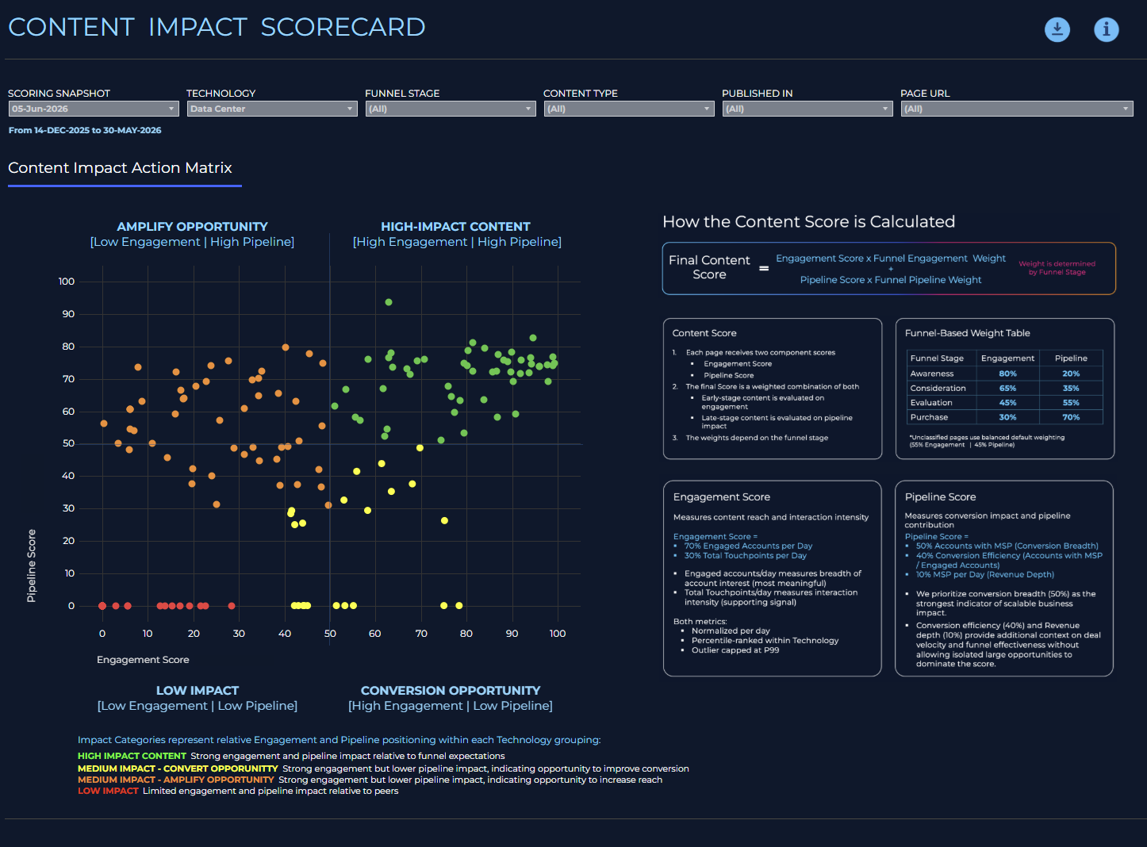
Content Impact Scorecard
1
Optimize
Mapping content by pipeline vs engagement we get a roadmap as to what to do such as amplify opportunity for low-engagement/high pipeline content etc.
2
Funnel Stage
Teams benefit from a scoring system that understands the user journey where we can monitor traffic by awareness, consideration and evaluation
3
Shows how content contributes to the bottom line by measuring “Conversion Breadth” and “Revenue Depth” to see what collateral is closing deals
Revenue
4
Retirement
Shows underperforming assets into a red bucket Signalling outdated web pages and content that should be decommissioned
Content Impact Scorecard

Slide 20
ID Combinations
Activity ID
Activity ID
Activity ID
cc010898
cc010912
cc011102
Drive To ID
Drive To ID
Drive To ID
oemels001119
psexsp001647
psoins001233
Eloqua Email
Google Paid Search
Insta Paid Social

